Slide 1
DAY 2
Tableau

Slide 2
Topics
Tableau
Database
Small group project

Slide 3
Tableau

Slide 4
Number Functions
Function | Example
CEILING (number) | CEILING(2.145) = 3
POWER (number, power) | POWER(5,3) = 125
ROUND (number, [decimals]) | ROUND(3.14152,2) = 3.14

Slide 5
String Functions
Function | Example
LEN (string) | LEN("Tableau") = 7
LTRIM (string) | LTRIM(" Tableau ") = "Tableau"
REPLACE (string, substring, replacement) | REPLACE("GreenBlueGreen", "Blue", "Red") = "GreenRedGreen"
UPPER (string) | UPPER("Tableau") = "TABLEAU"

Slide 6
Date Functions
Function | Example
DATEADD (date_part, increment, date) | DATEADD ('month', 3, #2004-04-15#) = 2004-0715 12:00:00 AM
DATENAME (date_part, date, [start_of_week]) | DATENAME('month', #200404-15#) = "April"
DAY (date) | DAY(#2004-04-12#) = 12
NOW( ) | NOW( ) = 2004-04-15 1:08:21 PM

Slide 7
Aggregate Functions
Function
AVG(expression)
MIN(expression)
COUNT (expression)
MEDIAN (expression)
STDEV (expression)

Slide 8
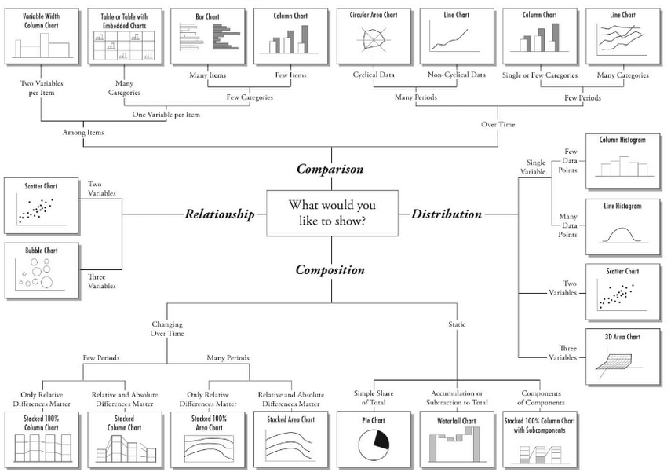
Presentation and Chart Types

Slide 9
Categorical and Quantitative Data (범주형, 계량형 데이터)
Data can be further classified as being categorical or quantitative. 데이터는 범주형, 계량형으로 나뉘어짐
Categorical data use labels or names to identify categories of like items. 범주형 데이터는 비슷한 아이템의 카테고리를 구분하는 레이블이나 이름을 사용하는 데이터들
Quantitative data are numerical values that indicate how much or how many 계량적 데이터는 얼마나 많은지를 나타내는 숫자들

Slide 10
Data
Categorical Data
Quantitative Data
Tabular
Displays
Graphical
Displays
Tabular
Displays
Graphical
Displays
Frequency
Distribution
Rel. Freq. Dist.
Percent Freq.
Distribution
Crosstabulation
Dot Plot
Histogram
Stem-and-
Leaf Display
Scatter
Diagram
Bar Chart
Pie Chart
Side-by-Side
Bar Chart
Stacked
Bar Chart
Frequency
Distribution
Rel. Freq. Dist.
% Freq. Dist.
Cum. Freq. Dist.
Cum. Rel. Freq.
Distribution
Cum. % Freq.
Distribution
Crosstabulation

Slide 11
데이터
범주형 데이터
계량형 데이터
테이블
그래프
테이블
그래프
Frequency
Distribution
Rel. Freq. Dist.
Percent Freq.
Distribution
Crosstabulation
Dot Plot
Histogram
Stem-and-
Leaf Display
Scatter
Diagram
Bar Chart
Pie Chart
Side-by-Side
Bar Chart
Stacked
Bar Chart
Frequency
Distribution
Rel. Freq. Dist.
% Freq. Dist.
Cum. Freq. Dist.
Cum. Rel. Freq.
Distribution
Cum. % Freq.
Distribution
Crosstabulation

Slide 12
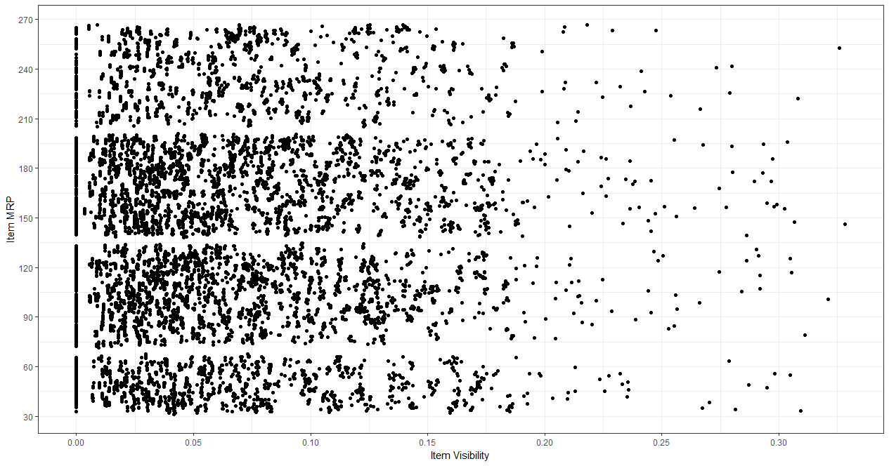
Scatter Plot (산점도)
Used to see the relationship between two continuous variables (두 연속변수사이의 관계)

Slide 13
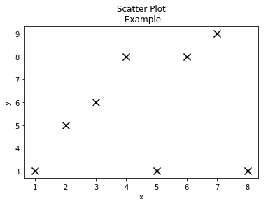
Example
x = [1, 2, 3, 4, 5, 6, 7 ,8]
y = [3, 5, 6, 8, 3, 8, 9, 3]
plt.scatter(x,y, color='k', marker='x', s=100)
plt.xlabel('x')
plt.ylabel('y')
plt.title('Scatter Plot\n Example')
plt.show()

Slide 14
Colors
You can also use hex string
color = '#eeefff‘
html names
color = 'red' color = 'burlywood’ color = 'chartreuse‘
Alias | Color
'b' | blue
'g' | green
'r' | red
'c' | cyan (청록)
'm' | magenta (자홍색)
'y' | yellow
'k' | black
'w' | white

Slide 15
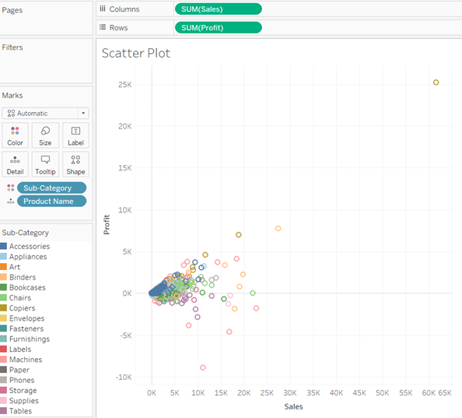
Exercise #2
https://www.tutorialspoint.com/tableau/tableau_scatter_plot.htm
X, Y값 집어넣고 안에 넣을 값을 선택함

Slide 16
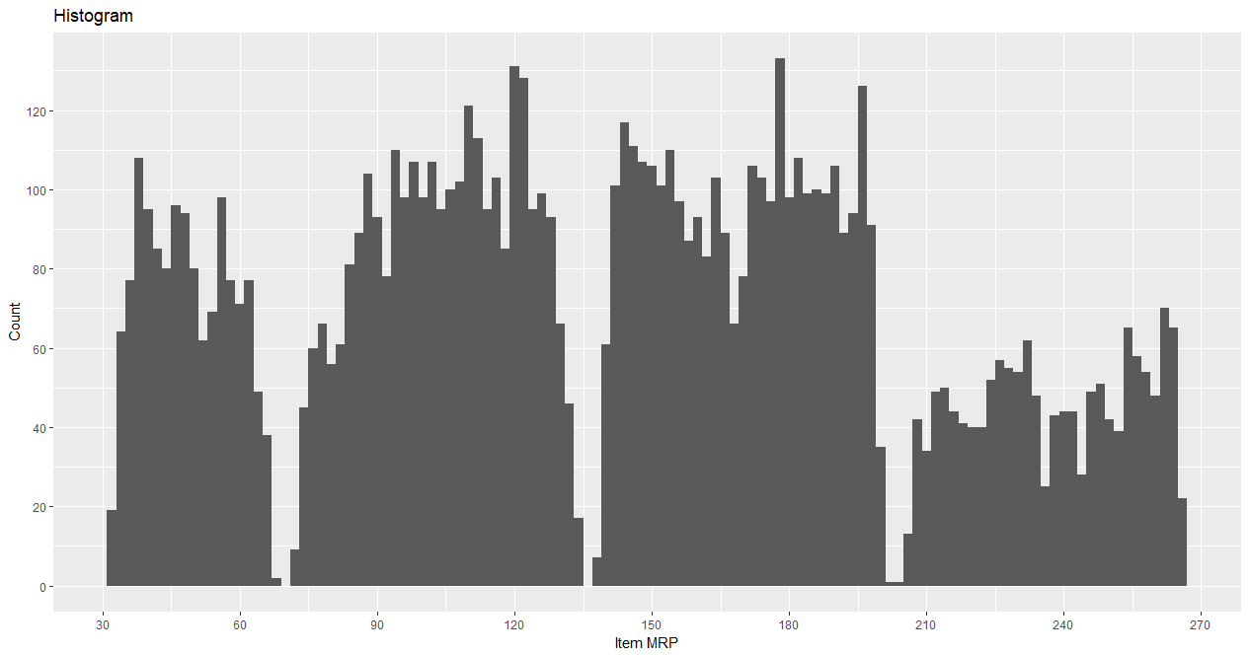
Histogram
Used to plot continuous variable (한개의 연속변수의 분포를 보여줌)
It breaks the data into bins and shows frequency distribution of these bins (빈도테이블을 그래프로!)

Slide 17
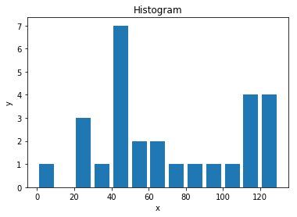
Example
population_ages = [22, 55, 62, 45, 21, 22, 34, 42, 42, 4, 99, 102, 110, 120, 121, 122, 130, 111, 115, 112, 80,75, 65, 54, 44, 43, 42, 48]
bins = [0, 10, 20, 30, 40 , 50, 60, 70, 80, 90, 100, 110, 120, 130]
plt.hist(population_ages, bins, histtype='bar', rwidth=.8)
plt.xlabel('x')
plt.ylabel('y')
plt.title('Histogram')
plt.show()

Slide 18
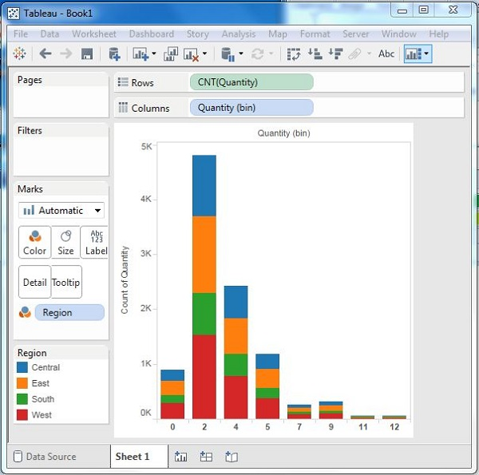
Exercise #2
https://www.tutorialspoint.com/tableau/tableau_histogram.htm
Drag the Measure named Quantity to the Rows shelf. Then open Show Me and select the Histogram chart. 퀄티티만 행에 갖다놓고 히스토그램 누름

Slide 19
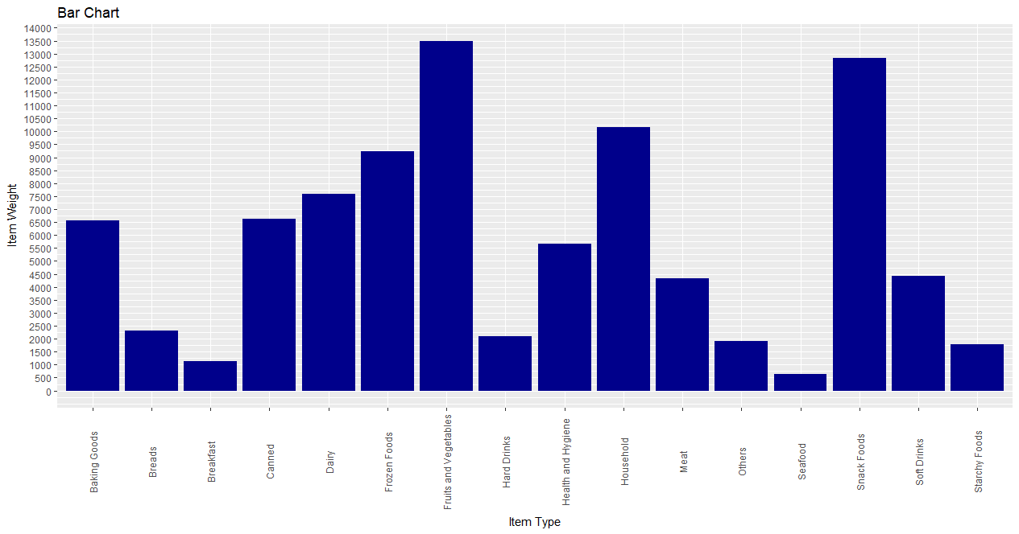
Bar Chart
Plots a categorical variable or a combination of continuous and categorical variable (범주형변수나 연속, 범주변수가 같이 있을때 사용할수 있음)

Slide 20
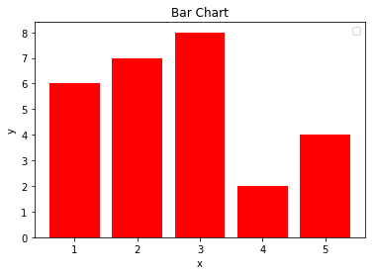
Example
x = [1, 2, 3, 4, 5]
y = [6 ,7, 8, 2, 4]
plt.bar(x,y, color='r')
plt.xlabel('x')
plt.ylabel('y')
plt.title('Bar Chart')
plt.legend()
plt.show()

Slide 21
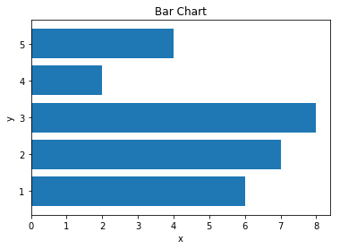
Horizontal Bar Chart
x = [1, 2, 3, 4, 5]
y = [6 ,7, 8, 2, 4]
plt.barh(x,y)
plt.xlabel('x')
plt.ylabel('y')
plt.title('Bar Chart')
plt.show()

Slide 22
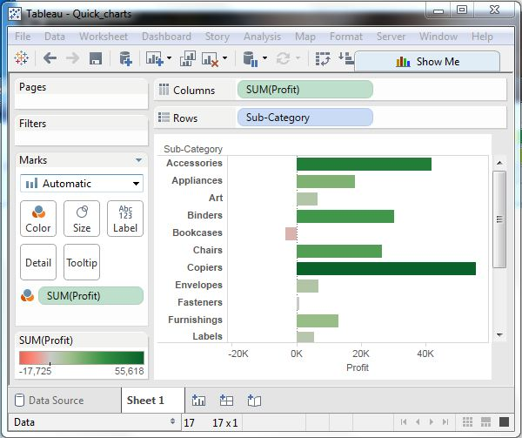
Exercise #2
https://www.tutorialspoint.com/tableau/tableau_bar_chart.htm

Slide 23
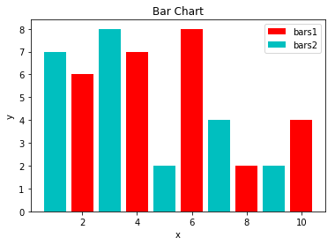
Combining Charts
x = [2, 4, 6, 8, 10]
y = [6 ,7, 8, 2, 4]
x2 = [1, 3, 5, 7, 9]
y2 = [7, 8, 2, 4, 2]
plt.bar(x, y, label='bars1', color='r')
plt.bar(x2, y2, label='bars2', color='c')
plt.xlabel('x')
plt.ylabel('y')
plt.title('Two Bar Charts')
plt.legend()
plt.show()

Slide 24
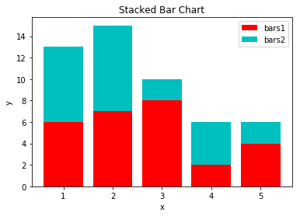
Stacked Chart
x = [1, 2, 3, 4, 5]
y1 = [6 ,7, 8, 2, 4]
y2 = [7, 8, 2, 4, 2]
plt.bar(x, y1, label='bars1', color='r')
plt.bar(x, y2, label='bars2', color='c', bottom=y1)
plt.xlabel('x')
plt.ylabel('y')
plt.title(‘Stacked Bar Chart')
plt.legend()
plt.show()

Slide 25
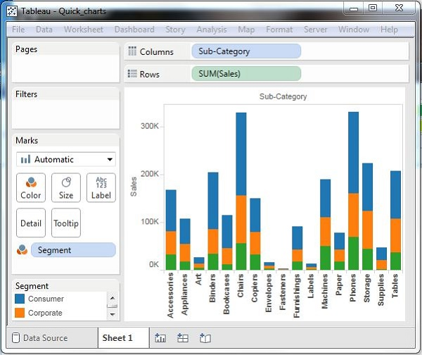
Exercise #2
https://www.tutorialspoint.com/tableau/tableau_histogram.htm
그래프에 세그먼트를 칼라로 집어넣음

Slide 26
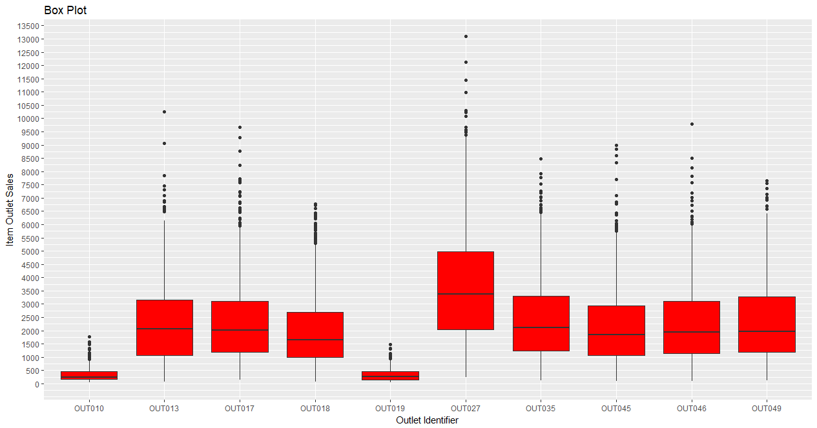
Box Plot
Used to plot a combination of categorical and continuous variables (범주형 변수와 연속변수의 관계를 보여줄때)

Slide 27
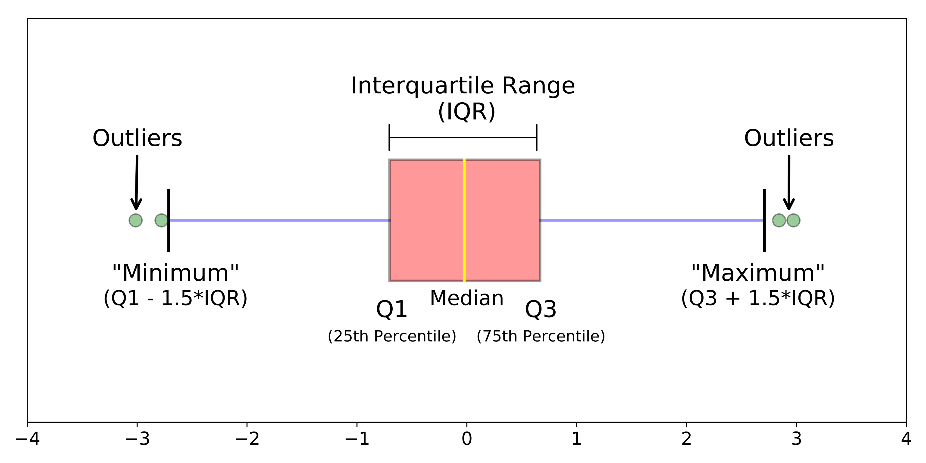
Boxplot
The median of a data set is the value in the middle when the data items are arranged in ascending order 중위수는 순서대로 정렬시 가운데 있는 값

Slide 28
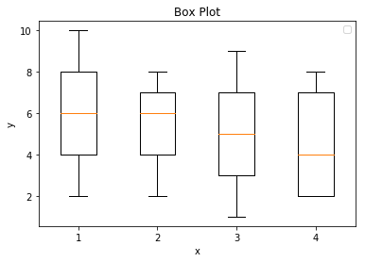
Example
Data = [[2, 4, 6, 8, 10],[6 ,7, 8, 2, 4],[1, 3, 5, 7, 9],[7, 8, 2, 4, 2]]
x = pd.DataFrame(data)
plt.boxplot(x)
plt.xlabel('x')
plt.ylabel('y')
plt.title('Box Plot')
plt.show()

Slide 29
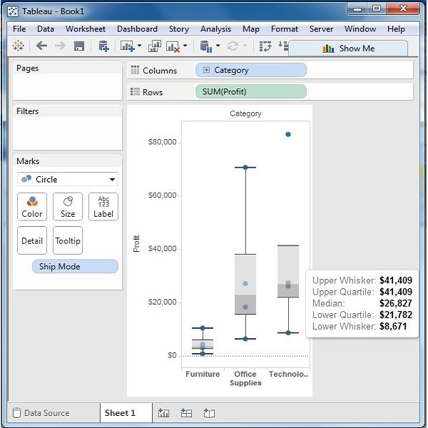
Exercise #2
https://www.tutorialspoint.com/tableau/tableau_box_plot.htm
카테고리, 쉽모드를 열에, 프라핏을 행에 넣은후 박스플랏을 선택

Slide 30
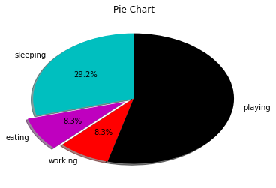
Pie Chart
slices = [7, 2, 2, 13] activities = ['sleeping','eating','working','playing'] cols = ['c','m','r','k'] plt.pie(slices, labels=activities, colors = cols, startangle=90, shadow=True, explode=(0,0.1,0,0), autopct='%1.1f%%') plt.title('Pie Chart') plt.show()

Slide 31
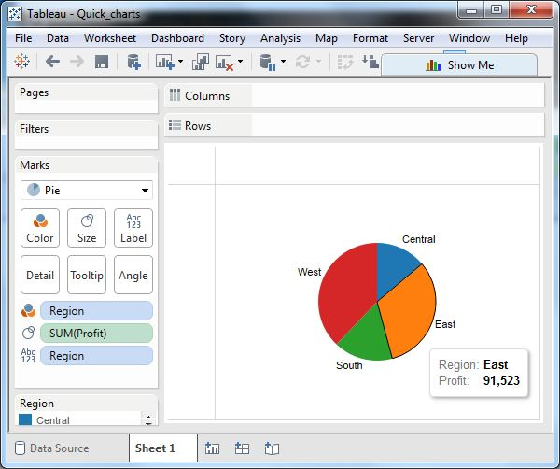
Exercise #2
https://www.tutorialspoint.com/tableau/tableau_pie_chart.htm
프라핏을 사이즈에 넣고 파이차트 체크! 지역을 칼라로 넣어주고 지역을 레이블로 줌

Slide 32
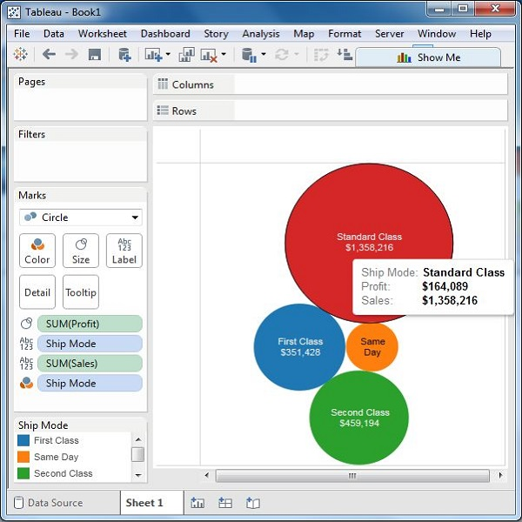
Bubble Chart
Can plot a combination of categorical and continuous variables (범주형 변수와 연속변수의 관계를 보여줄때)

Slide 33
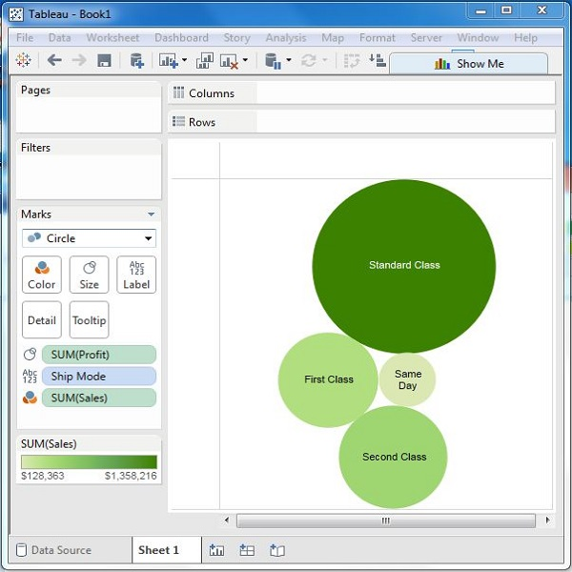
Exercise #2
https://www.tutorialspoint.com/tableau/tableau_bubble_chart.htm
칼라를 바꿀때는 칼라 → Edit Color → Palette를 바꿈

Slide 34
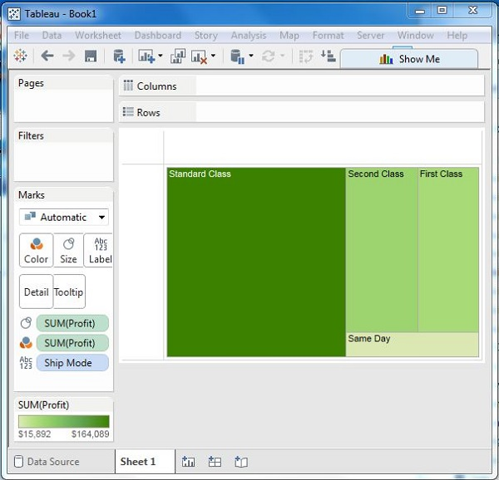
Tree Map
https://www.tutorialspoint.com/tableau/tableau_tree_map.htm

Slide 35
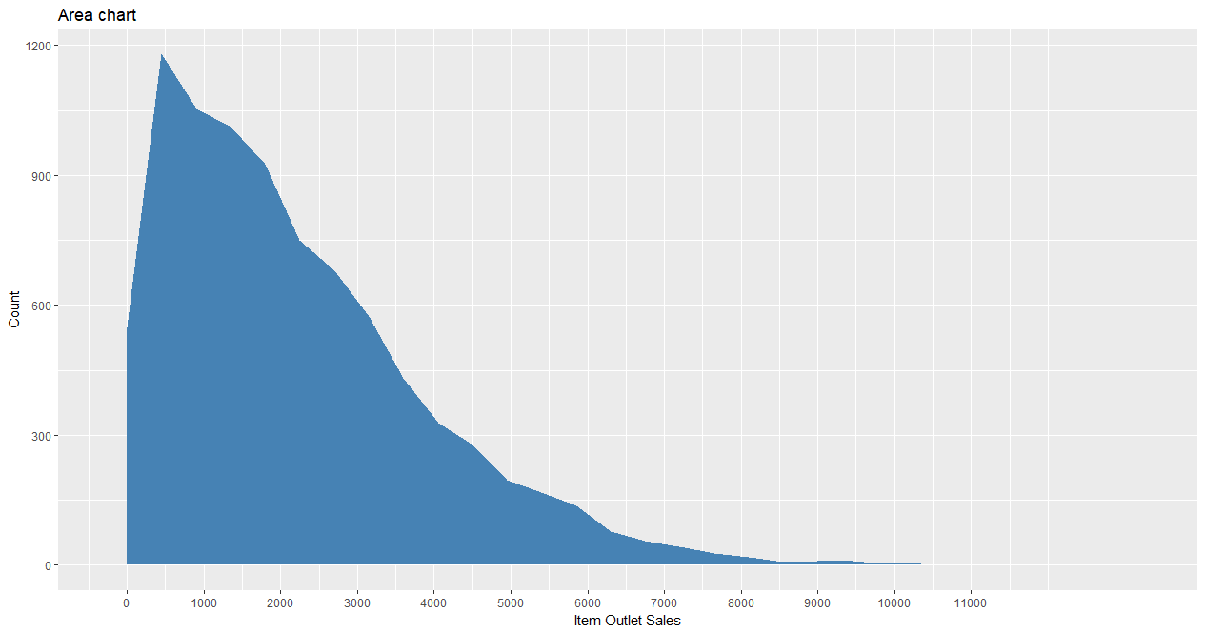
Area Chart
Used to show continuity across a variable or data set (연속변수의 빈도를 나타낼때)

Slide 36
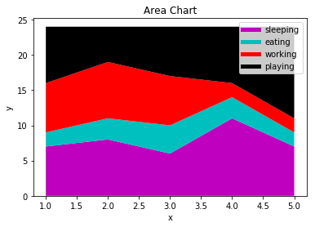
Example
days = [1, 2, 3, 4, 5] sleeping = [7, 8, 6, 11, 7] eating = [2, 3, 4, 3, 2] working = [7, 8, 7, 2, 2] playing = [8, 5, 7, 8, 13] plt.stackplot(days, sleeping, eating, working, playing, colors=['m', 'c', 'r', 'k']) plt.xlabel('x') plt.ylabel('y') plt.title('Area Chart') plt.legend() plt.show()

Slide 37
Legends
plt.plot([],[],color='m', label='sleeping', linewidth=5)
plt.plot([],[],color='c', label='eating', linewidth=5)
plt.plot([],[],color='r', label='working', linewidth=5)
plt.plot([],[],color='k', label='playing', linewidth=5)
Place this code any places above legend() 범례함수전에 코드를 집어넣어야 함

Slide 38
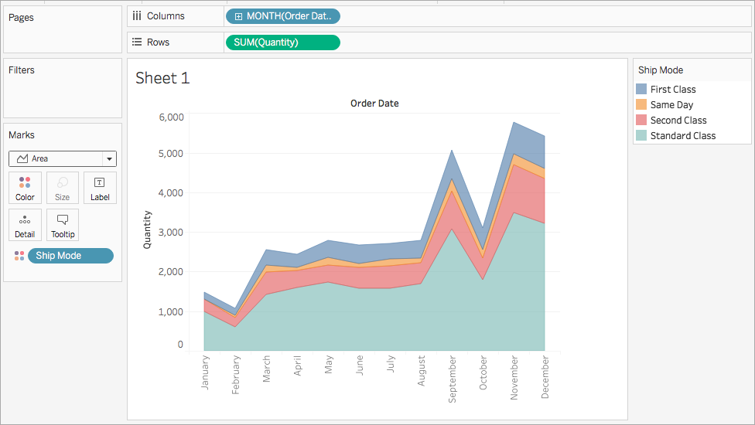
Exercise #2
https://help.tableau.com/current/pro/desktop/en-us/qs_area_charts.htm

Slide 39
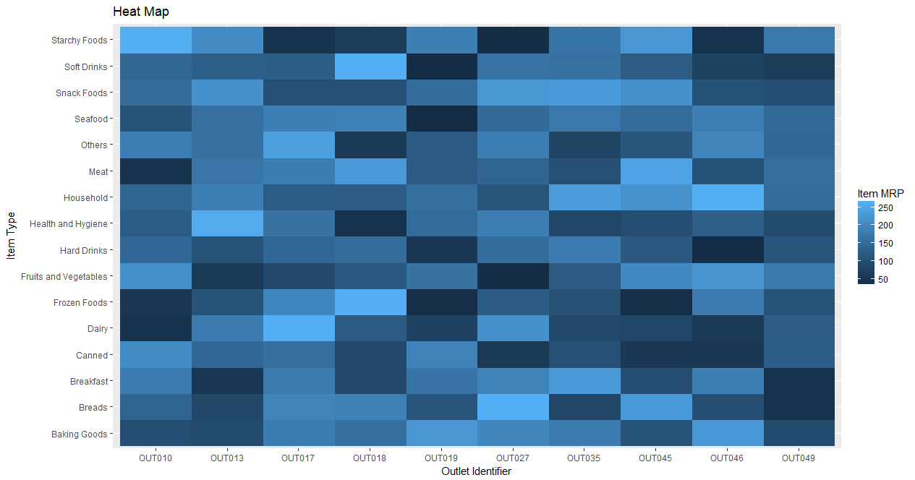
Heat Map
Uses intensity of colors to display relationship between two or three or many variables in a two dimensional image (2개이상 변수의 관계를 색의 진하기로 나타냄)
Explores two dimensions as the axis and the third dimension by intensity of color 2개의 변수는 각각의 축으로, 3번째 변수는 색의 진하기 정도로

Slide 40
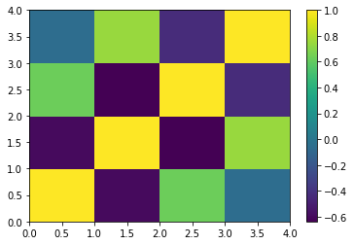
Example
data=[[2,3,4,1],[6,3,5,2],[6,3,5,4],[3,7,5,4],[2,8,1,5]] #5x4 matrix
Index= ['I1', 'I2','I3','I4','I5']
Cols = ['C1', 'C2', 'C3','C4'] #4 variables
df = pd.DataFrame(data, index=Index, columns=Cols)
plt.pcolor(df.corr()) #plt.matshow(df.corr())
plt.colorbar()
plt.show()
Positive co-relations are displayed in yellow and negative correlations in dark blue color 양의 관계는 노란색, 음의 관계는 어두운 파란색

Slide 41
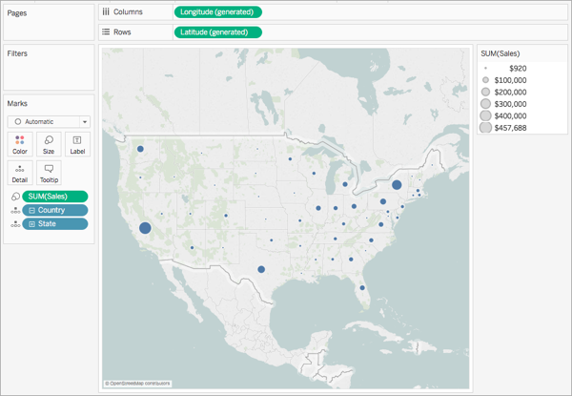
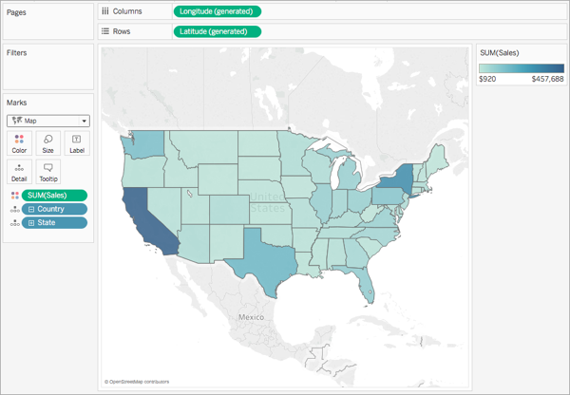
Exercise #2
Complete the map tutorial on https://help.tableau.com/current/pro/desktop/en-gb/maps_howto_simple.htm
Point Map
Polygon Map

Slide 42
Exercise #2 Chipotle Example
Analyze the Chipotle data using graphs
Scatter plot
Histogram
Bar chart, horizontal bar chart, stacked bar chart
Box plot
Area chart
Heat map (if possible)

Slide 43
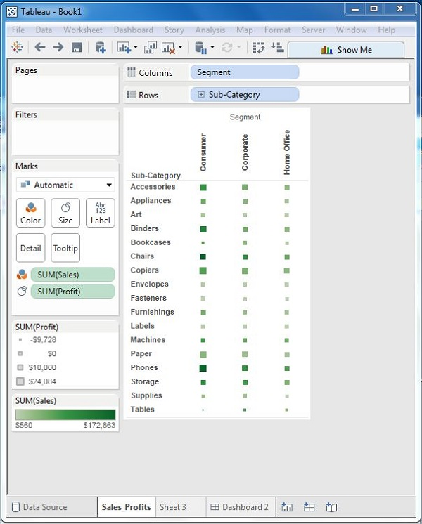
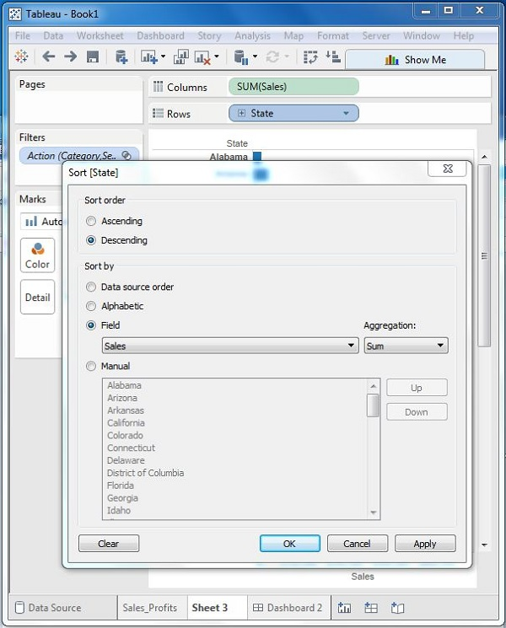
Exercise #2
https://www.tutorialspoint.com/tableau/tableau_dashboard.htm
Sales_Profits Worksheet
Sales_state Worksheet

Slide 44
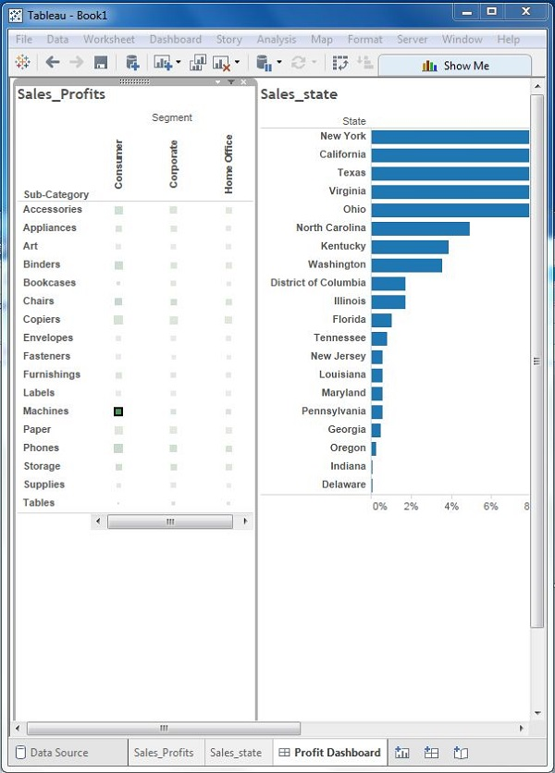
Exercise #2
Profit_Dashboard
대시보드를 만든후 필터를 이용하여 어떻게 데이터가 연결되는지 확인하시요

Slide 45
Exercise #2 Occupation Example
Analyze the Occupation data using graphs
Scatter plot
Histogram
Bar chart, horizontal bar chart, stacked bar chart
Box plot
Area chart
Heat map (if possible)
Point map/polygon map (if possible)
Create a dashboard

Slide 46
Exercise #2 World Food Facts
Analyze the world food fact data using graphs
Scatter plot
Histogram
Bar chart, horizontal bar chart, stacked bar chart
Box plot
Area chart
Heat map (if possible)
Point map/polygon map (if possible)
https://www.kaggle.com/openfoodfacts/world-food-facts/data

Slide 47
Database

Slide 48
Spreadsheet vs. Database
Spreadsheet
Database
Data Entry
Data Structure
Data Entry

Slide 49
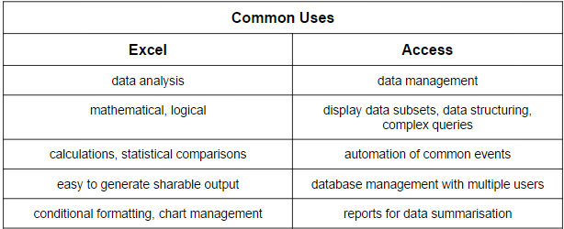
Difference between Spreadsheet and Database
데이터분석, 수학, 로직, 계산, 통계, 조건포맷, 차트
데이터관리, 데이터 구조화, 복잡한 질의, 자동화, 다중사용자, 리포트
Notes:
https://www.makeuseof.com/tag/excel-vs-access-can-spreadsheet-replace-database/

Slide 50
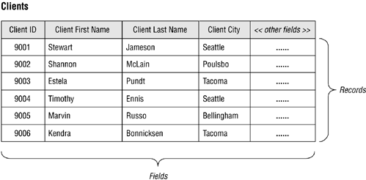
Tables
A record is composed of fields and contains all the data about one particular person, company, or item in a database. 필드로 구성되어 있고, DB안에 있는 각각의 사람, 회사, 아이템등이 레코드임
A field is part of a record and contains a single piece of data for the subject of the record. 레코드의 일부분으로 레코드에 대한 속성을 포함하고 있음

Slide 51
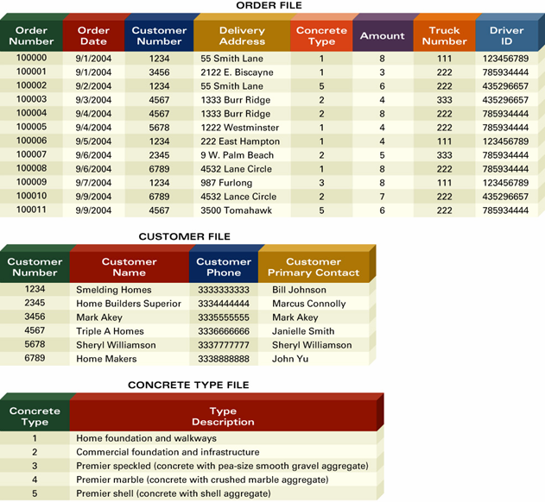
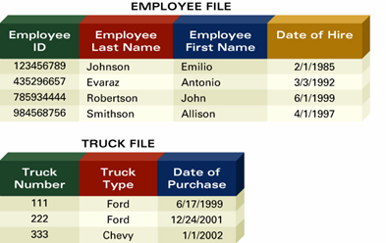
Database
Collection of information that you organize and access according to the logical structure of the information 논리적 구조를 갖는 정보 (테이블)를 모아놓은 것이 데이터베이스

Slide 52
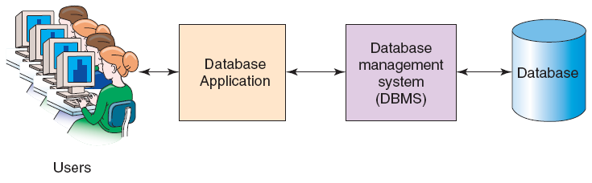
Database Management System (DBMS)
A software system designed to create, store, manage, and facilitate access to databases 데이터베이스를 만들고, 저장하고, 관리할수 있는 소프트웨어
Serves as an intermediary between database applications and the database. 데이터베이스와 어플리케이션 사이에서 중개하는 역할
The DBMS also manages and controls database activities. 데이터베이스 사용자활동도 관리할수 있음

Slide 53
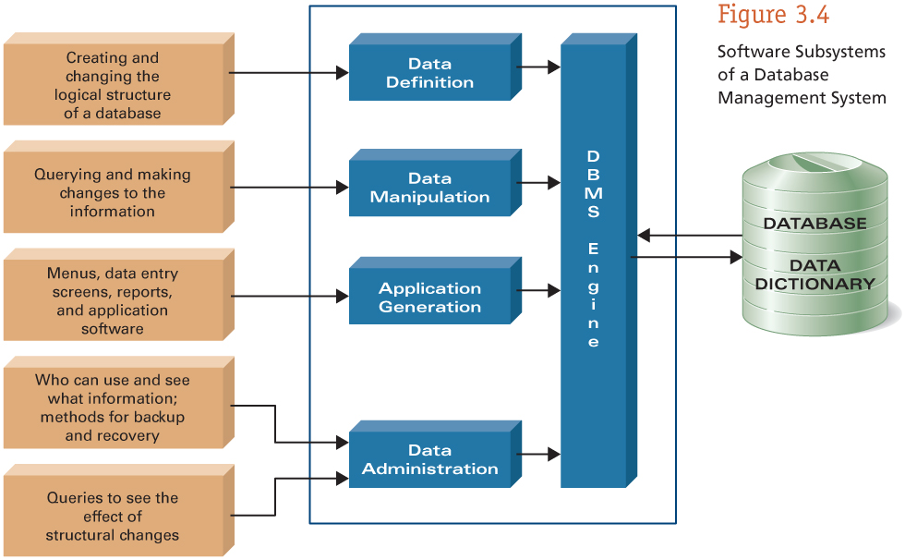
5 Components of a DBMS
It serves as an intermediary between database applications and the database 실제 데이터베이스와 어플리케이션 사이를 중재

Slide 54
Data Definition Subsystem
You create and maintain the data dictionary and structure of the files in a database 데이터베이스 안에 있는 데이터의 정의 및 구조를 정함
The data dictionary helps you define:
Field names 필드이름
Data types (numeric, etc) 데이터타입
Form (do you need an area code) 형식
Default value 기본값 설정
Is an entry required, etc 필수항목 등

Slide 55
Data Manipulation Subsystem
You can add, change, and delete information in a database and query it to find valuable information 데이터베이스 안에 데이터를 더하거나 바꾸거나 지울수 있고 검색할수도 있음
Includes views, report generators, query-by-example tools, and structured query language 뷰, 리포트, QBE, SQL을 포함

Slide 56
Application Generation Subsystem
Contains facilities to help you develop transaction-intensive applications 어플리케이션을 만들수 있음
Mainly used by IT professionals 주로 IT담당자가 만듬

Slide 57
Data Administration Subsystem
You can manage the overall database environment by providing facilities for:
Backup and recovery 백업 및 복구
Security management 보안관리
Query optimization - minimizes response times for large, complex queries 쿼리최적화
Reorganization - for physically rearranging the structure of the information 재조직
Concurrency control - what happens if two people attempt to make changes to the same record 동시에 두사람이 같은 레코드를 바꿀려고 할때
Change management - how will structural changes impact the overall database 바꾼것을 관리

Slide 58
DBMS Engine
Accepts logical requests and converts them into the physical equivalents, and access the database and data dictionary on a storage device 논리적 요청을 받아서 물리적 요청으로 변환
Physical view – how information is physically arranged, stored, and accessed on a storage device 물리적으로 어떻게 저장됐고 접근할수있나
Logical view – how you need to arrange and access information to meet your needs 필요에 따라 정보를 정렬, 접근

Slide 59
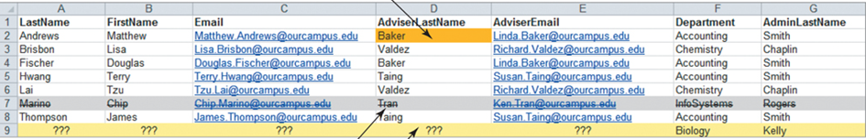
Problems with DBMS
Redundancy 반복성
Multiple Themes 여러개의 주제가 한꺼번에 들어있음
Modification Issues 수정문제
Deletion problems (data lost), insertion problems (data missing), update problems (need to update all related data multiple times) 데이터를 지우다가 데이터가 사라질수있고, 입력하다가 데이터가 빠질수 있고, 업데이트할때 반복해서 내용을 넣어야 함
If a particular person is managing 10 projects, his/her information would have to be entered 10 times. 어떤 특정한 사람이 10개의 프로젝트에서 일한다면 그 사람에 대한 정보를 10번 입력해야 함
A list of Projects may include Project Manager information and Project information in the same row. 프로젝트 리스트에 프로젝트 관리자 정보와 프로젝트 정보가 한줄에 같이 들어감

Slide 60
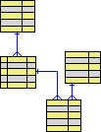
Relational Database 관계형 데이터베이스
Most popular database model 가장 많이 쓰이는 데이터베이스 모델
Series of logically related two-dimensional tables or files for storing information 논리적으로 연관된 2차원 테이블들이나 파일들의 집합
Tables within a relational database are related to each other. 관계형 데이터베이스안에 있는 테이블들은 서로 연관되어 있음

Slide 61
RDB Example
For example, a Project List can be divided into a CUSTOMER Table, a PROJECT Table, and a PROJECT_MANAGER Table. 프로젝트 리스트는 고객 테이블, 프로젝트 테이블, 프로젝트관리자 테이블로 나눌수 있음
A relational database breaks up a list into several tables—one table for each theme to minimize data redundancy while preserving complex relationships among themes. 리스트를 하나의 리스트를 여러개의 테이블로 쪼갬. 데이터중복을 최소화하기 위해 각 테이블에는 한가지 주제만 집어넣고 관계로 연결

Slide 62
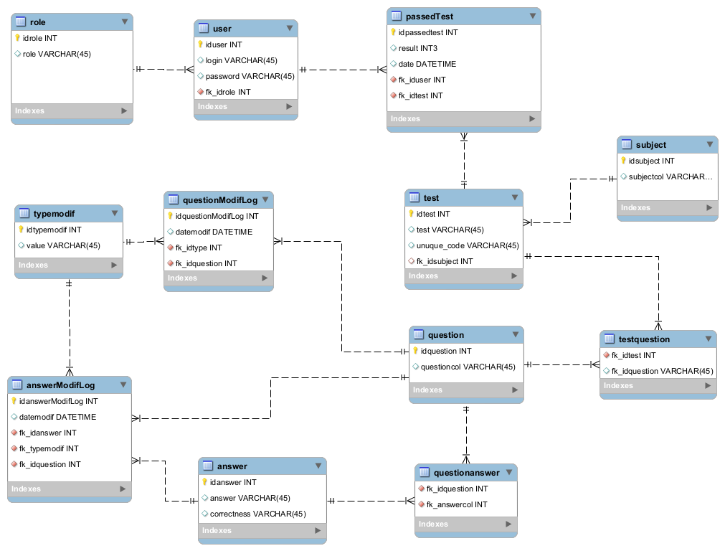
Relational Database Management Systems (RDBMS)
An application or collection of applications designed to create, store, manage, and facilitate access to relational databases 관계형 데이터베이스를 생성, 저장, 관리하는 어플리케이션
The RDBMS also manages and controls database activities. 사용자의 데이터베이스 사용활동 관리

Slide 63
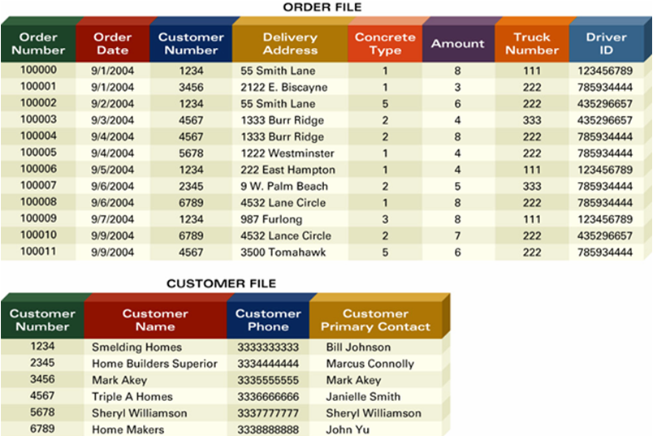
Primary Key 기본키
Field (or group of fields) that uniquely describes each record 각 레코드를 구분하게 해주는 필드
Order Number is the primary key for Order and Customer Number is the primary key for Customer 주문테이블에는 주문번호, 고객테이블에는 고객번호등

Slide 64
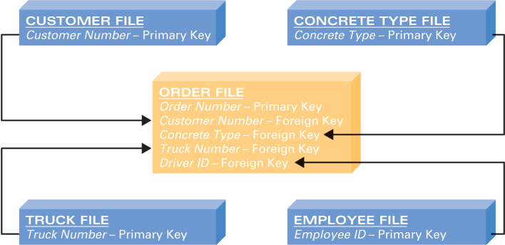
Foreign Key 외래키
Primary key of one file that appears in another file 기본키가 다른 테이블에 나타나면 외래키
Customer Number appears in Order as a foreign key 주문테이블에 있는 고객번호는 외래키

Slide 65
Integrity Constraints
Rules that help ensure the quality of information 정보의 질을 유지하기 위한 방법
Data dictionary, for example, defines type of information – numeric, date, and so on 데이터 정의어를 이용하여 데이터 타입를 정함. 데이터 타입이 안맞으면 에러!!!
Foreign keys – must be found as primary keys in another file 외래키로 사용하기 위해서는 다른 테이블의 기본키여야 함
E.g., a Customer Number in the Order Table must also be present in the Customer Table 고객테이블에 고객넘버가 있어야 주문테이블에서 고객넘버를 사용할수 있음

Slide 66
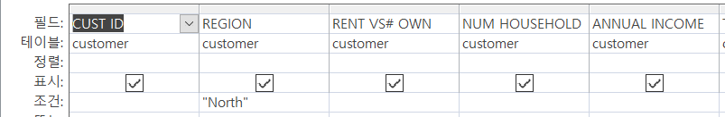
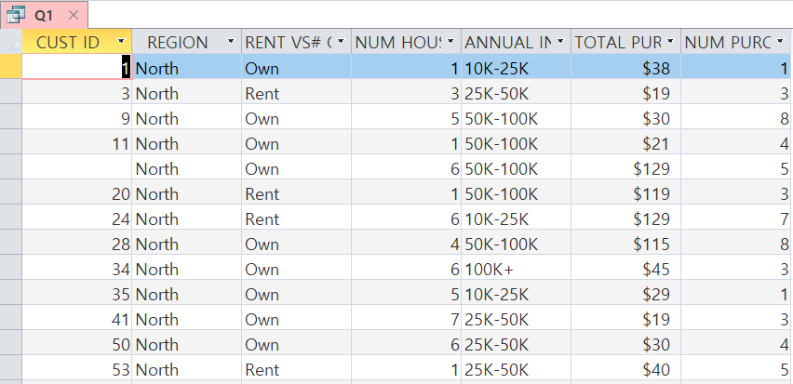
Exercise #2
Import XLMD_Customer.xls and create queries to answer the following questions: xlmd_customer파일을 임포트한후에 다음 질문에 답하시요
Q1. Open Show all information for only customers who live in the North region. 북쪽에 사는 고객들의 정보를 보여주시요
Run!!

Slide 67
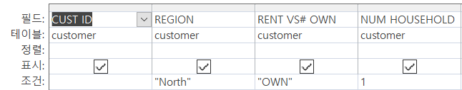
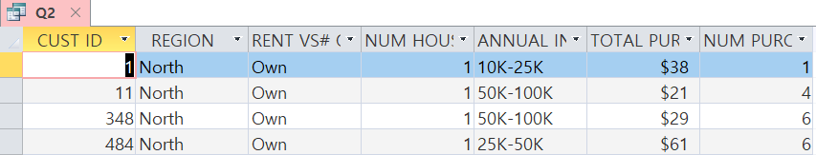
Exercise #2
Q2. Show all information for only customers who (a) live in the North region, (b) own their homes, and (c) have only one household member. 북쪽에 살면서 자기집을 소유하고, 1명의 가정구성원을 가진 고객의 정보를 보여주시요
Run!!

Slide 68
Exercise #2
Q3. Show all information for customers who have at least 4 household members. 최소 4명의 가족구성원을 가진 고객들의 정보를 보여주시요
Q4. Show all information for customers who (a) have spent less than $20 or (b) more than $100. 20불미만 100불이상 소비한 고객들의 정보를 보여주시요
Q5. Provide a two-dimensional table using crosstab that counts the number of customers by the categories of REGION and RENT VS. OWN. 크로스탭을 이용하여 2차원 테이블을 만들되 지역과 렌트대소유에 따른 고객들의 수를 보여주시요

Slide 69
Exercise #2
Q6. Provide a two-dimensional table using crosstab that sums the TOTAL PURCHASES of customers by the categories of REGION and RENT VS. OWN. 크로스탭을 이용하여 2차원 테이블을 만들되 지역과 렌트대소유에 따른 고객들의 총구매액의 합을 보여주시요
Q7. Provide a query using Totals that counts the number of customers by the categories of REGION, RENT VS. OWN, and NUM HOUSEHOLD. 토탈스를 이용하여 쿼리를 만들되 지역, 렌트대소유, 가족구성원의 수에 따른 고객들의 수를 보여주시요
Q8-Q10. Create three more queries to answer your questions on this database. 추가적으로 3개 쿼리를 더 만드시요
Notes:
Refer to http://highered.mheducation.com/sites/007337685x/student_view0/online_xlm_files.html for Xlm D.

Slide 70
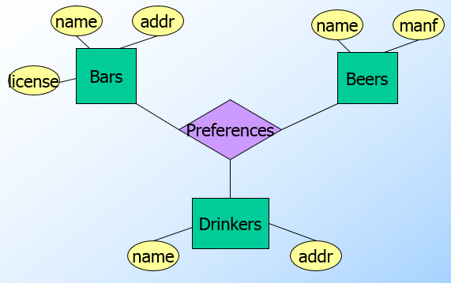
ER Diagram
Entity-Relationship
Widely used in database design 데이터베이스 디자인에 많이 사용됨
Represent conceptual level of a database system 가장 높은 레벨에서의 디자인

Slide 71
Basic Concepts in ER Diagram
Entity – “thing” or object, e.g., student 어떤 개체, 예를 들어 학생
Attribute – property of an entity, e.g. student id, student name, student email, etc. 개체의 속성, 예를 들어 학생아이디, 이름, 이메일 등
Relationship – relations among entities from two or more entities 두개이상의 개체사이의 관계

Slide 72
Relationships
One-to-one relationship
Many-to-many relationship
One record in the first table corresponds to many records in the second table. 한 테이블에 있는 한 레코드가 다른 테이블에 있는 여러 레코드와 매치
One record in one table has many matching records in a second table, and one record in the related table has many matching records in the first table. 한 테이블에 있는 한 레코드가 다른 테이블에 있는 여러 레코드와 매치되고 다른 테이블에 있는 한 레코드도 이 테이블에 있는 여러개의 레코드와 매치될 때
A record in one table has only one matching record in the second table. 한 테이블에 있는 한 레코드가 다른 테이블에 있는 한 레코드와 매치
One-to-many relationship

Slide 73
Types of ER Diagrams
Information Engineering (IE) [James Martin 1990]
Uses “crow’s feet” to show the many sides of a relationship, and it is sometimes called the crow’s foot model. 까마귀 발 모양을 이용하여 그림
Integrated Definition 1, Extended 3 (IDEF1X)
A version of the E-R model that is a national standard. 국가표준
Unified Modeling Language (UML)
A set of structures and techniques for modeling and designing object-oriented programs (OOP) and applications 모델링하는 테크닉의 하나인 UML에서 사용하는 다이어글매

Slide 74
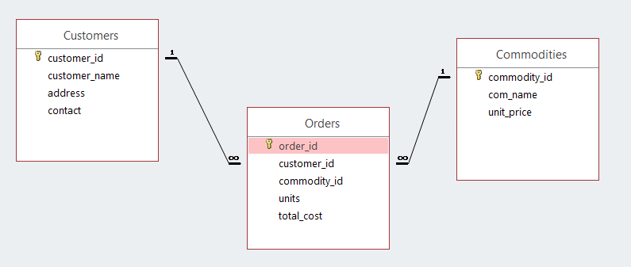
Exercise #2
Create tables for online shop and a relationship among these tables, and enter some data 온라인숍 테이블과 관계를 만든후 데이터를 입력하시요
Refer to Extended Learning Module J on page 473-487 (Implementing a database with MS Access)

Slide 75
SQL
SQL is Structured Query Language 구조화된 질의어
Some people pronounce SQL as “sequel” 씨퀄이라고 발음할수도 있고
Other people insist that only “ess-cue-ell” is the only correct pronunciation 에스큐엘이라고 발음해도 됨
Just about every relational database supports SQL 거의 모든 관계형 데이터베이스들은 SQL을 지원함

Slide 76
SQL (cont.)
SELECT CUSTOMER.CustomerLastName,
CUSTOMER.CustomerFirstName,
CUSTOMER.Phone,
COURSE.CourseDate, ENROLLMENT.AmountPaid,
COURSE.Course, COURSE.Fee
FROM CUSTOMER, ENROLLMENT, COURSE
WHERE CUSTOMER.CustomerNumber
= ENROLLMENT.CustomerNumber
AND COURSE.CourseNumber
= ENROLLMENT.CourseNumber;
An international standard (ANSI) for creating, processing, and querying databases and their tables. 데이터베이스와 테이블을 만들고, 처리하고, 질의하기 위한 국제표준

Slide 77

NoSQL Database
A database that does not use SQL. SQL을 이용하지 않는 데이터베이스
It is a non-relational database 관계형 데이터베이스가 아님
Facebook and Twitter (Web 2.0 Applications) use Apache Software Foundation Cassandra database to quickly create and store massive amounts of data 패이스북, 트위터는 캐산드라 데이터베이스를 이용하여 많은 양의 데이터를 생성하고 저장함

Slide 78

SQL vs. NoSQL

Slide 79
Commercial DBMS Products
Desktop DBMS Products
Microsoft Access
Organizational DBMS Products
Microsoft’s SQL Server
Oracle’s Oracle
Sun Microsystem’s MySQL
IBM’s DB2

Slide 80

Microsoft Access 2010

Slide 81

Personal Database Systems

Slide 82

Microsoft SQL Server 2014

Slide 83

Oracle Database Express Edition 11g Release 2

Slide 84

MySQL 5.6

Slide 85

Organizational Database Systems

Slide 86

Database Engine Ranking

Slide 87
Community Edition Databases
IBM DB2 Express-C
Relational DB with XML support
Free edition of IBM DB2
https://www.ibm.com
Oracle 11g Express Edition (XE)
Leading market share among commercial databases
XE is easier to administer than full Oracle
http://www.oracle.com

Slide 88
Free RDBMS
MySQL
One of the most popular open-source relational database management systems (RDBMS) commonly used in web applications 웹개발에 주로 쓰이는 오픈소스 관계형 데이터베이스
Free for non-commercial use only, owned by Oracle 비상업적 용도는 공짜
Handles very large databases; very fast performance. 아주 큰 데이터베이스를 다룰수 있고 아주 빠름
Easy to use with Java JDBC 자바와 사용하기 편함

Slide 89
Free RDBMS (cont.)
PostgreSQL
Open Source, can be used in commercial apps without a license 라이센스없이 상업용 앱에 사용할수 있음
Included with Linux distros
http://www.postgresql.org
Derby
Lightweight, pure Java database 사이즈가 작은, 순수 자바 데이터베이스
included with JavaEE as "Java DB"
http://db.apache.org/derby

Slide 90
Free RDBMS (cont.)
Hypersonic SQL
Lightweight, fast database written in Java 자바로 쓰여진 사이즈가 작고, 빠른 데이터베이스
Useful for development and "demo" systems
http://hsqldb.org
SQLite
World's most widely distributed database written in C C로 쓰여짐
Used by several widespread browsers, operating systems, or mobile phones
https://www.sqlite.org/

Slide 91
Free RDBMS (cont.)
Berkeley DB
written in C with language bindings for C++, Perl, Python, Ruby, and more libraries for embedded database using the OS's file system.
bought by Oracle in 2006.
http://www.oracle.com/database/berkeley-db/index.html (still Open Source under the "Sleepycat Public License" and "Sleepycat Commercial License”)

Slide 92
Oracle 11g Express Edition (XE)
Leading market share among commercial databases 상업 데이터베이스 중에서 가장 마켓점유율이 높음
XE is easier to administer than full Oracle
http://www.oracle.com/technetwork/database/database-technologies/express-edition/downloads/index.html

Slide 93

SQL Command Line
Start menu → Programs (or All Programs) → Oracle Database 11g Express Edition → Run SQL Command Line.

Slide 94
SQL*Plus
Pronounced sequel plus
An interactive and batch query tool that is installed with every Oracle Database Express Edition installation 오라클 설치할때 함께 설치됨
It has a command-line user interface that acts as the client when connecting to the database. 명령어기반 사용자 인터페이스
You can enter and run SQL*Plus commands, SQL statements, PL/SQL statements, and operating system commands. 다양한 명령어를 실행할수 있음

Slide 95

Connecting to Oracle Database Express Edition from SQL*Plus
Search Windows → cmd → sqlplus
Notes:
https://docs.oracle.com/cd/E17781_01/admin.112/e18585/toc.htm#XEGSG120

Slide 96
Oracle SQL Developer
A graphical version of SQL*Plus that gives database developers a convenient way to perform basic tasks. SQL*PLUS의 그래픽한 버젼
You can browse database objects, run SQL statements and SQL scripts, and edit and debug PL/SQL statements. 데이터베이스 오브젝트 검색, 명령어 실행, 명령어 편집, 디버깅 등을 할수 있음
You can also run any number of provided reports, as well as create and save your own. 리포트 생성

Slide 97
PL/SQL (Procedural Language/SQL)
Pronounced P L sequel
A native Oracle Database Express Edition extension to SQL.
Bridges the gap between declarative and imperative program control by adding procedural elements, such as conditional control and loops. SQL에 프로그램적인 요소를 가미

Slide 98
Exercise #2
Download and install Oracle Database Express Edition 11g Release 2
File - http://www.oracle.com/technetwork/database/database-technologies/express-edition/downloads/index.html
Instructions - https://docs.oracle.com/cd/E17781_01/install.112/e18803/toc.htm#XEINW101
#1 for overview, #4 for installation instructions, #5 for executing Oracle DB XE

Slide 99
Exercise #2
Complete p.23-28.
Search windows → type cmd → type sqlplus in the command windows → id – system, password – 1234
ALTER USER HR IDENTIFIED BY your_password ACCOUNT UNLOCK;
Use employees table instead of emp table.

Slide 100
Exercise #2
Install SQL Developer
File - http://www.oracle.com/technetwork/developer-tools/sql-developer/overview/index.html
Instructions - https://docs.oracle.com/cd/E17781_01/admin.112/e18585/toc.htm
#1 for user interface
#3 for installation
#4.1 for database connection

Slide 101
Exercise #2 Foothills Construction Company Example
The Foothills Construction Company needs a relational database developed to track project details according to project name, hours assigned and charges per hour for each job description. From a list of entity classes (and their primary keys) and a list of integrity constraints, develop a database for Foothills Construction Company.

Slide 102

ER Diagram

Slide 103

Job Table

Slide 104

Employee Table

Slide 105

Assign Table

Slide 106

Project Table

Slide 107

Query for Report

Slide 108
Data Mining Tools

Slide 109

Data-Mining Tools
Software tools you use in a data warehouse environment
Query-and-reporting tools
Artificial intelligence
Multidimensional analysis tools
Digital dashboards
Statistical tools

Slide 110

Query-by-Example (QBE) Tool
You can graphically design the answer to a question 질의어를 만들어 데이터마이닝

Slide 111

Report Generator
You can quickly define formats of reports and what information you want to see in a report 리포트를 만들어 데이터마이닝

Slide 112
Structured Query Language (SQL)
An international standard for creating, processing, and querying databases and their tables. SQL을 이용하여 데이터마이닝
SELECT CUSTOMER.CustomerLastName,
CUSTOMER.CustomerFirstName,
CUSTOMER.Phone,
COURSE.CourseDate, ENROLLMENT.AmountPaid,
COURSE.Course, COURSE.Fee
FROM CUSTOMER, ENROLLMENT, COURSE
WHERE CUSTOMER.CustomerNumber
= ENROLLMENT.CustomerNumber
AND COURSE.CourseNumber
= ENROLLMENT.CourseNumber;

Slide 113

Artificial Intelligence
Tools to help you “discover” information and trends 인공지능툴이나 알고리즘을 이용하여 데이터마이닝

Slide 114

Multidimensional Analysis (MDA tools)
Slice-and-dice techniques for viewing multidimensional information 다차원정보를 잘라서 데이터마이닝

Slide 115

Digital Dashboard
Displays key information on a computer screen tailored to the needs and wants of an individual 필요에 따라 주요성과지표를 요약
Key performance indicator (KPI) – most essential information used in any analytics initiative 주요성과지표를 시각화

Slide 116

Statistical Tools
Applying mathematical models to data warehouse information. e.g., linear regression 회귀분석같은 수학모델을 이용하여 데이터마이닝

Slide 117

Exercise #1
Create a simple library database with three tables: books, patrons, and transaction 세개의 테이블을 가진 도서관 데이터베이스를 만드시요
You can import the given text files into the tables. If you can’t directly import the text files into Access, copy and paste into Excel then import the Excel file 데이터를 텍스트파일로 만들어서 임포트하던가 엑셀파일로 만들어서 임포트할수 있음

Slide 118
Sample SQL Code for books and patrons
create table books(
book_id char(13),
title varchar(100),
author_name varchar(50),
publisher varchar(50),
genre varchar(50),
constraint pk_book_id primary key (book_id));
create table patrons(
patron_id char(5),
patron_name varchar(80),
gender char(1),
age number,
address varchar(200),
constraint pk_patron_id primary key (patron_id));

Slide 119
Sample SQL Code for transaction
create table transaction(
transaction_id char(5),
patron_id char(5),
book_id char(13),
transaction_date char(50),
transaction_year char(4),
transaction_month varchar(2),
constraint pk_transaction_id primary key(transaction_id),
constraint fk_patron_id foreign key(patron_id) references patron(patron_id),
constraint fk_book_id foreign key(book_id) references book(book_id));

Slide 120


Exercise #2
Create relationships among tables and produce a ER Diagram report. 테이블사이의 관계를 만들고 ER다이어그램 리포트를 만드시요
Create queries to answer the following questions 다음의 질문을 답할수 있는 질의어를 만들시요
Total number of books?
Total number of patrons?
Total number of transactions?

Slide 121


Exercise #2
Number of transactions by year?
Number of transactions by genre?
Number of transactions by month?

Slide 122


Exercise #2
Number of transactions by genre and gender?
Number of transactions by month and gender?

Slide 123


Number of Transactions by Year

Slide 124

Exercise #2
Build a “Dashboard” that summarize information about the patrons, books, and transactions 고객, 책, 거래내역에 대한 정보를 요약하는 대시보드를 만드시요
Export the result of queries to Excel and create appropriate charts for your data 쿼리결과를 엑셀로 엑스포트해서 적절한 그래프를 그리시요
Summarize the result and charts using a PowerPoint slide 파워포인트를 이용해서 결과와 차트를 요약하시요

Slide 125
Group Project
Design a simplified database for any businesses such as grocery store, motel, insurance, airline, housing, library, etc. and create an actual database using MS Access or Oracle Database 11g Express, populate the data, and write interactive queries, and reports on the database
Form a team with 2-3 people
Create a new user account “am_group” with password “1234”

Slide 126
Group Project
Create tables
The database include at least three tables. For example, books, patrons (people who have library cards), and transactions (checking a book out, returning a book, and so on)
Create ERD and relational model using reverse engineering
Insert data into the tables
Use a sequence for one of your primary keys
Import your data from three different data sources (e.g., text file, excel file, MS Access, or Oracle database)

Slide 127
Group Project
Create a view that returns information about your customers and their transactions
For example, this view queries the PATRONS and TRANSACTIONS tables, and returns rows that contain a patron's ID, last name, and first name, along with a transaction and the transaction type. The rows are ordered by patron ID, and by transaction type within patron IDs

Slide 128
Group Project
Create a report to summarize information about customers, products, and their transactions
Build a “Dashboard” that summarize information about customers, products, and their transactions

Slide 129


Story
A sequence of visualizations that work together to convey information. When you share a story – for example, by publishing a workbook to Tableau Public, Tableau Server, or Tableau Online – users can interact with the story to reveal new findings or ask new questions of the data.

Slide 130
Exercise #2
Complete the story tutorial on https://help.tableau.com/current/pro/desktop/en-us/story_create.htm

